Slide 1
Exploratory data analysis of RNA-seq data with MetaOmGraph
Urminder Singh

Slide 2
Exploratory data analysis
Exploratory Data Analysis (EDA) is an approach to data analysis
Promoted by John Tukey to encourage statisticians to explore the data
Explore data in order to
Summarize various characteristics of the data
Uncover the hidden structure and patterns in data
Check assumptions for fitting a statistical model
Detect outliers in the dataset
Formulate hypothesis

Slide 3
Tools for exploratory data analysis
Most techniques used in EDA are graphical and a few are quantitative
Quantitative
Median polish, Trimean, Ordination etc.
Graphical
Scatter plots, Box plot, Histograms, Parallel coordinates, Heat maps etc.

Slide 4
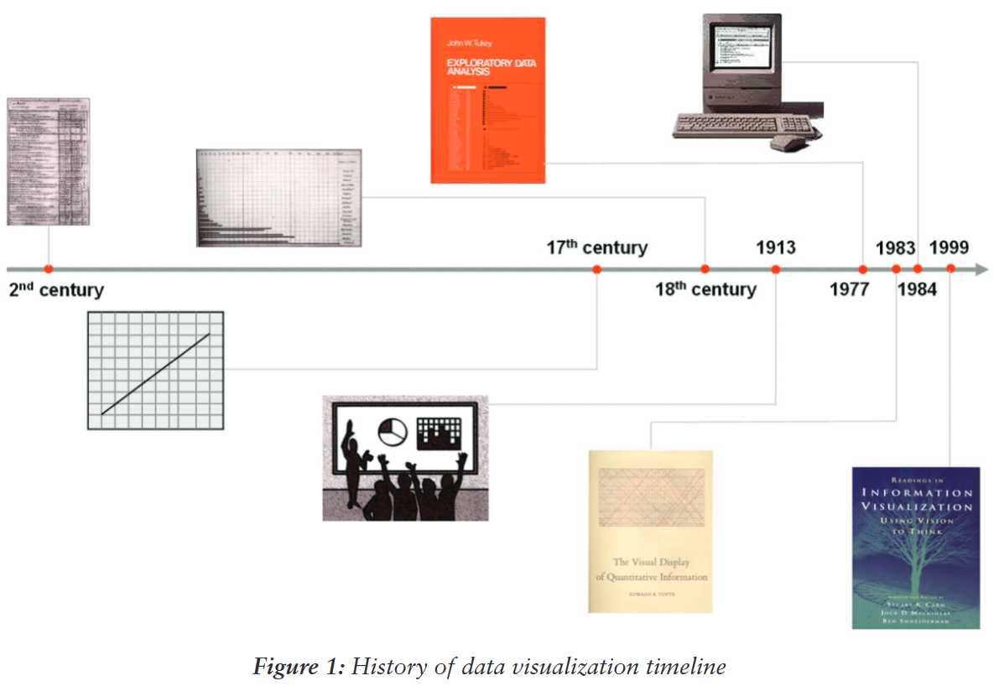
Data visualization
Communicate data by encoding it as visual objects
Goal is to convey the idea efficiently and effectively
Earliest example of data visualization dates back to 2nd century
Ref: Few, Stephen, and Perceptual Edge. "Data visualization: past, present, and future." IBM Cognos Innovation Center (2007).

Slide 5
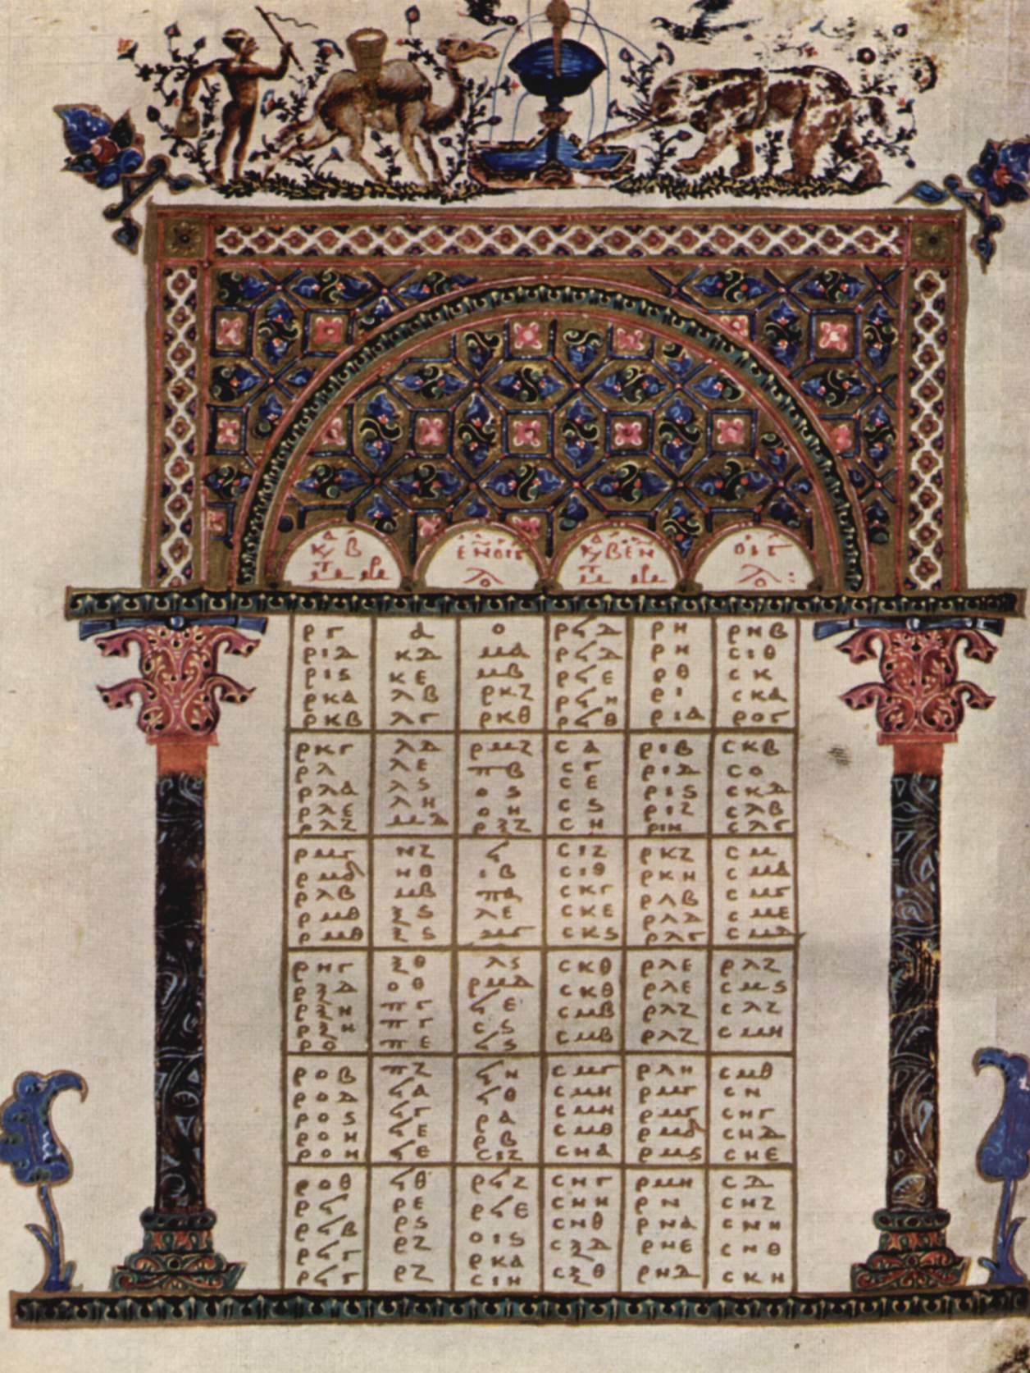
Data visualization history
The earliest visualization arose in geometric diagrams of celestial bodies and maps.
Descartes invented the graph in 17th century.
Early beginnings of statistical theory and data collection in 18th century
Rapid growth in statistical graphics. bar and pie charts, histograms, line graphs, contour plots, scatter plots were invented in 19th century.
In 1950 John W. Tukey published The Future of Data Analysis
In 1960, the possibility to construct new graphics with computers
Presently, we have high-dimensional data to visualize. Challenging to have dynamic and interactive visualizations
10th century table Ref: https://commons.wikimedia.org/wiki/Medieval_diagram

Slide 6
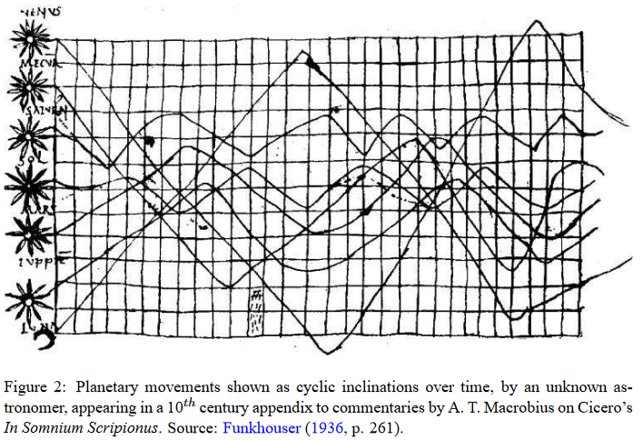
Data visualization history
The earliest visualization arose in geometric diagrams of celestial bodies and maps.
Descartes invented the graph in 17th century.
Early beginnings of statistical theory and data collection in 18th century
Rapid growth in statistical graphics. bar and pie charts, histograms, line graphs, contour plots, scatter plots were invented in 19th century.
In 1950 John W. Tukey published The Future of Data Analysis
In 1960, the possibility to construct new graphics with computers
Presently, we have high-dimensional data to visualize. Challenging to have dynamic and interactive visualizations
Ref: Friendly, Michael. "A brief history of data visualization." Handbook of data visualization. Springer, Berlin, Heidelberg, 2008. 15-56.

Slide 7
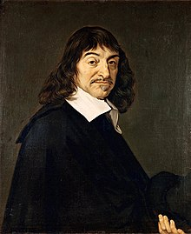
Data visualization history
The earliest visualization arose in geometric diagrams of celestial bodies and maps.
Descartes invented the graph in 17th century.
Early beginnings of statistical theory and data collection in 18th century
Rapid growth in statistical graphics. bar and pie charts, histograms, line graphs, contour plots, scatter plots were invented in 19th century.
In 1950 John W. Tukey published The Future of Data Analysis
In 1960, the possibility to construct new graphics with computers
Presently, we have high-dimensional data to visualize. Challenging to have dynamic and interactive visualizations
René Descartes was a French philosopher, mathematician, and scientist. Ref: https://en.wikipedia.org/wiki/Ren%C3%A9_Descartes

Slide 8

Data visualization history
The earliest visualization arose in geometric diagrams of celestial bodies and maps.
Descartes invented the graph in 17th century.
Early beginnings of statistical theory and data collection in 18th century
Rapid growth in statistical graphics. bar and pie charts, histograms, line graphs, contour plots, scatter plots were invented in 19th century.
In 1950 John W. Tukey published The Future of Data Analysis
In 1960, the possibility to construct new graphics with computers
Presently, we have high-dimensional data to visualize. Challenging to have dynamic and interactive visualizations
Thomas Bayes was an English statistician, philosopher. Bayes’ theorem is named after Reverend Thomas Bayes, who first provided an equation that allows new evidence to update beliefs in his An Essay towards solving a Problem in the Doctrine of Chances Ref: https://en.wikipedia.org/wiki/Thomas_Bayes

Slide 9
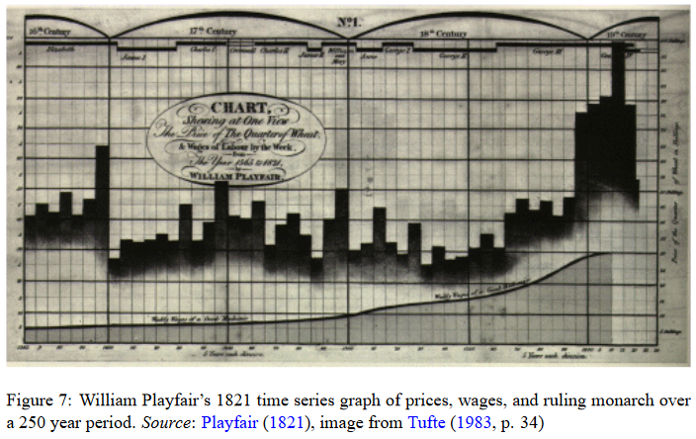
Data visualization history
The earliest visualization arose in geometric diagrams of celestial bodies and maps.
Descartes invented the graph in 17th century.
Early beginnings of statistical theory and data collection in 18th century
Rapid growth in statistical graphics. bar and pie charts, histograms, line graphs, contour plots, scatter plots were invented in 19th century.
In 1950 John W. Tukey published The Future of Data Analysis
In 1960, the possibility to construct new graphics with computers
Presently, we have high-dimensional data to visualize. Challenging to have dynamic and interactive visualizations
Ref: Friendly, Michael. "A brief history of data visualization." Handbook of data visualization. Springer, Berlin, Heidelberg, 2008. 15-56.

Slide 10

Data visualization history
The earliest visualization arose in geometric diagrams of celestial bodies and maps.
Descartes invented the graph in 17th century.
Early beginnings of statistical theory and data collection in 18th century
Rapid growth in statistical graphics. bar and pie charts, histograms, line graphs, contour plots, scatter plots were invented in 19th century.
In 1950 John W. Tukey published The Future of Data Analysis
In 1960, the possibility to construct new graphics with computers
Presently, we have high-dimensional data to visualize. Challenging to have dynamic and interactive visualizations
John Tukey was an American mathematician best known for development of the FFT algorithm, box plot and EDA. Ref: https://en.wikipedia.org/wiki/Exploratory_data_analysis

Slide 11
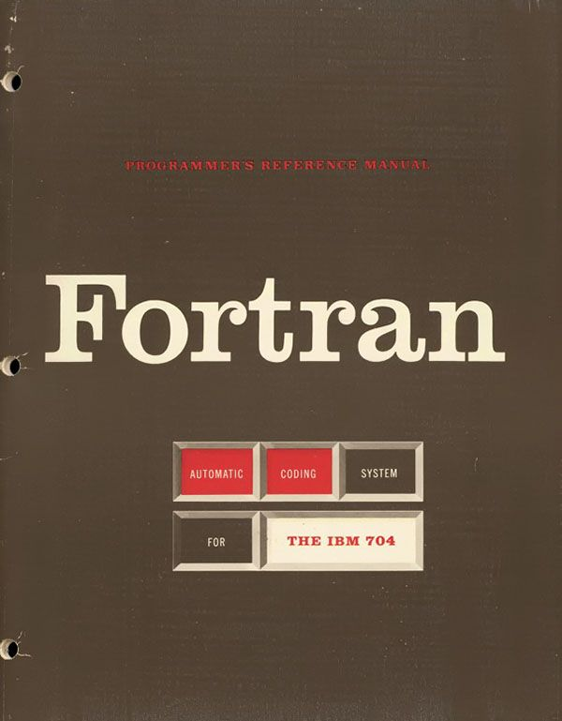
Data visualization history
The earliest visualization arose in geometric diagrams of celestial bodies and maps.
Descartes invented the graph in 17th century.
Early beginnings of statistical theory and data collection in 18th century
Rapid growth in statistical graphics. bar and pie charts, histograms, line graphs, contour plots, scatter plots were invented in 19th century.
In 1950 John W. Tukey published The Future of Data Analysis
In 1960, the possibility to construct new graphics with computers
Presently, we have high-dimensional data to visualize. Challenging to have dynamic and interactive visualizations
Fortran is a general-purpose, compiled imperative programming language that is especially suited to numeric computation and scientific computing originally developed by IBM. Ref: https://en.wikipedia.org/wiki/Fortran

Slide 12
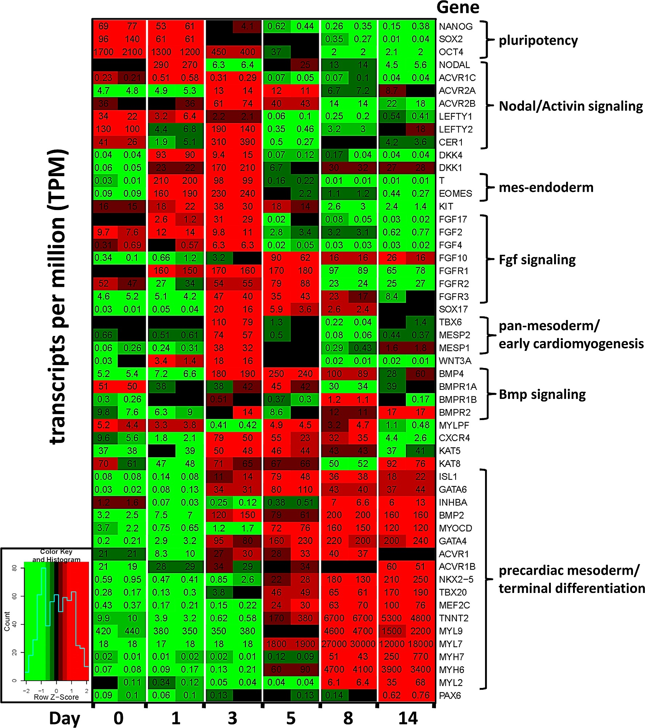
Data visualization history
The earliest visualization arose in geometric diagrams of celestial bodies and maps.
Descartes invented the graph in 17th century.
Early beginnings of statistical theory and data collection in 18th century
Rapid growth in statistical graphics. bar and pie charts, histograms, line graphs, contour plots, scatter plots were invented in 19th century.
In 1950 John W. Tukey published The Future of Data Analysis
In 1960, the possibility to construct new graphics with computers
Presently, we have high-dimensional data to visualize. Use of dimensionality reduction like PCA. Challenging to have dynamic and interactive visualizations
RNA-seq heat map example Ref: Kim, Min-Su, et al. "Activin-A and Bmp4 levels modulate cell type specification during CHIR-induced cardiomyogenesis." PLoS One 10.2 (2015): e0118670.

Slide 13
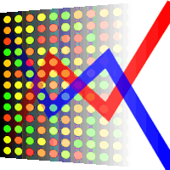
MetaOmGraph
MetaOmGraph (MOG) is a software for statistical analysis and interactive exploration of big datasets
MOG is free and open source, written in java
MOG can run on windows, mac and unix based machines
MOG is designed for analysis of multiple RNA-seq datasets, but can be used with other datasets as well.
MOG is around 65,000 lines of code
MOG developers
Previous: Nick Ransom and Manhoi Hur
Present: Urminder Singh

Slide 14
MetaOmGraph for analysis of RNA-seq
User can interactively visualize expression levels of hundreds of genes/transcripts
User can explore and analyze expression levels of hundreds of genes/transcripts under specific conditions
User can find association between genes /transcripts using
Pearson correlation
Spearman correlation
Mutual information
User can make statistical inference about associated genes/transcripts

Slide 15
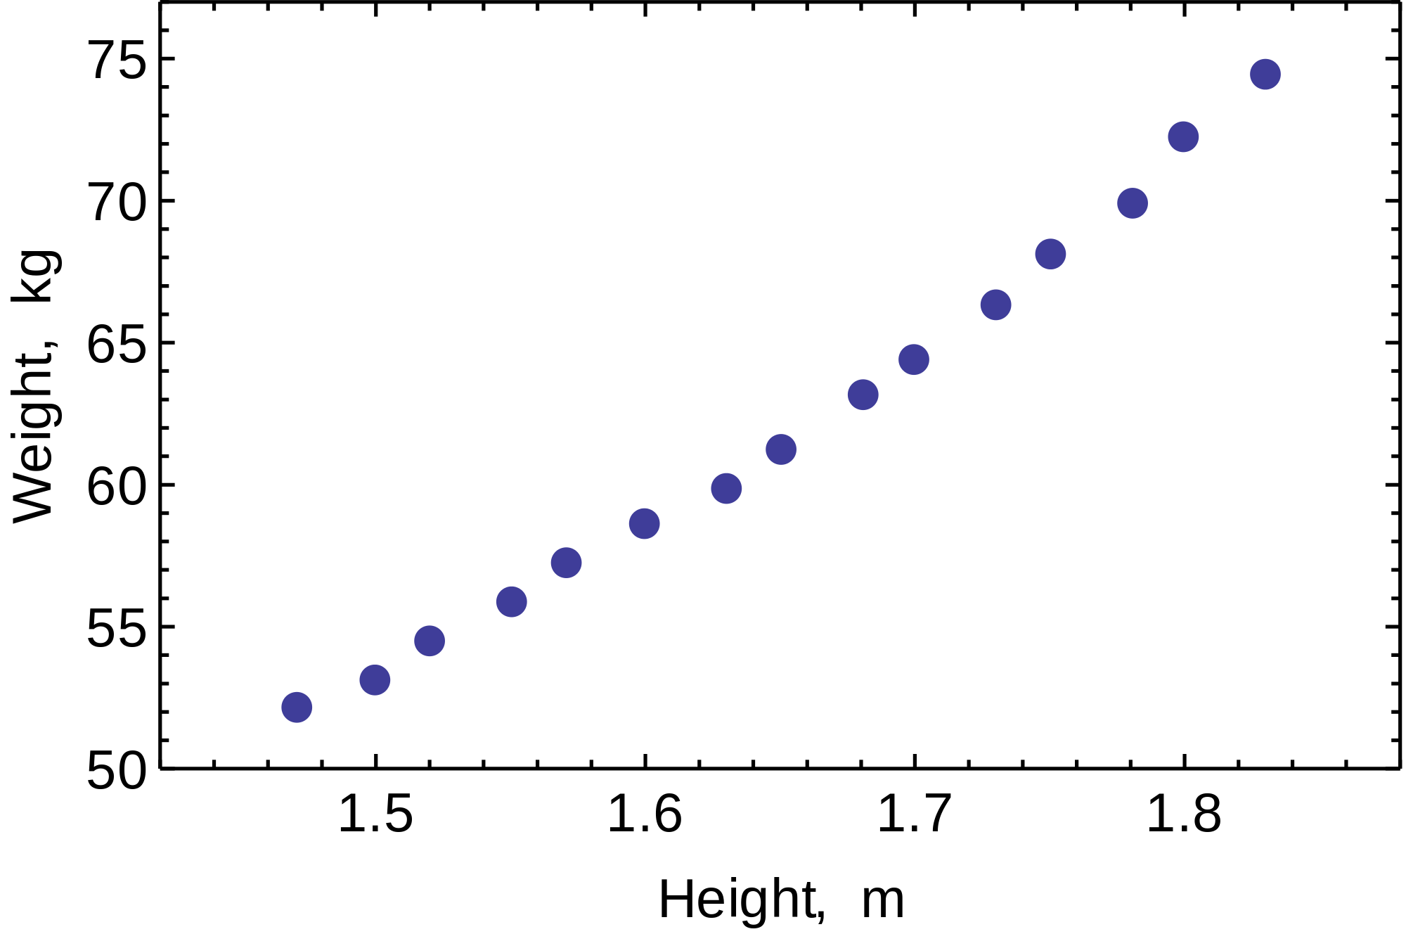
Finding associations in data
Is there an association between height and weight?
Statistical Association between any two variables tells how the variables are related
An association measure quantifies this “relatedness”
Association is not always causation
Must be careful in interpreting associations
Relationship between height and weight looks linear Ref: https://en.wikipedia.org/wiki/Ordinary_least_squares

Slide 16
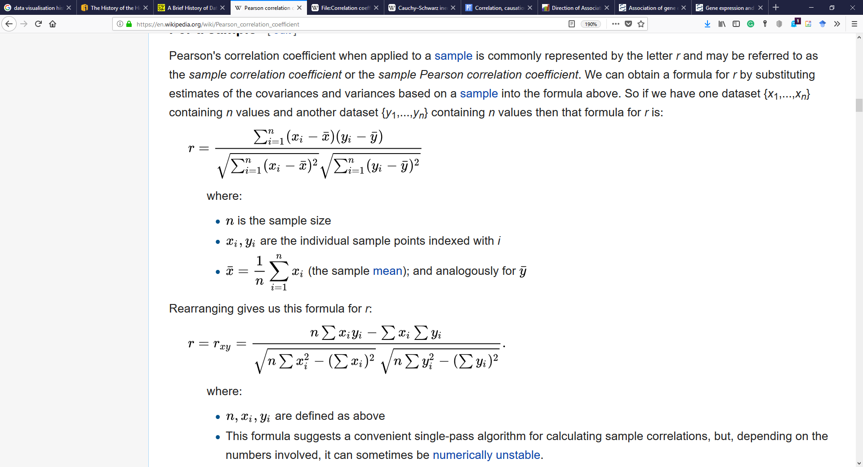
Pearson correlation coefficient
Pearson correlation coefficient, r, between two variables X and Y is a measure of the linear correlation between X and Y.
r can have a value between [-1,1] where
1 implies total positive linear correlation
0 is no linear correlation
−1 is total negative linear correlation

Slide 17
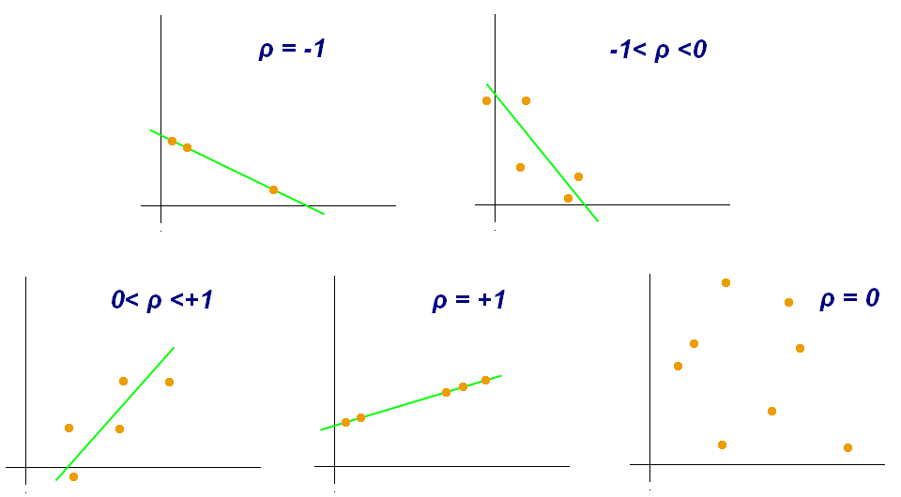
Pearson correlation coefficient
Examples of scatter diagrams with different values of Pearson correlation coefficient (ρ) Ref: https://en.wikipedia.org/wiki/Pearson_correlation_coefficient

Slide 18
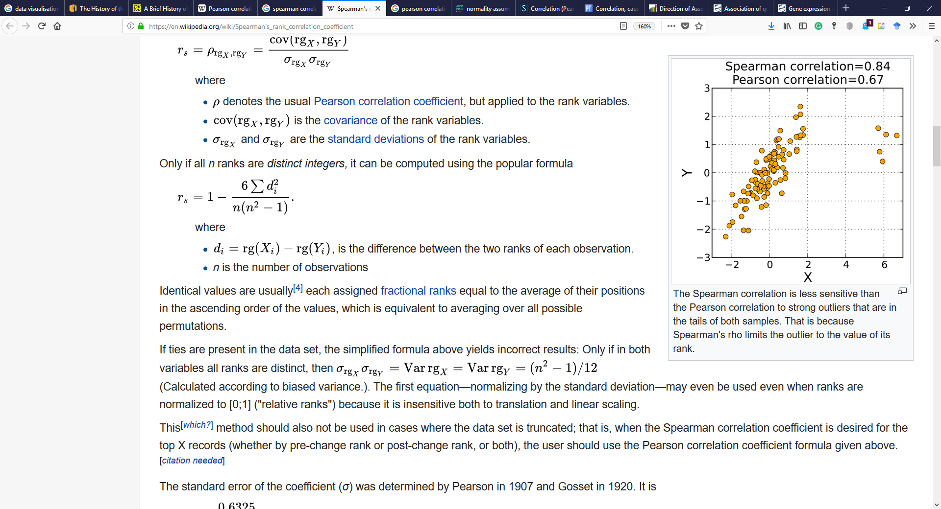
Spearman’s correlation
Spearman's rank correlation coefficient, r_{s}, is a nonparametric measure of rank correlation
It tells how well the relationship between two variables can be described using a monotonic function.
It is equal to the Pearson correlation between the rank values of those two variables

Slide 19
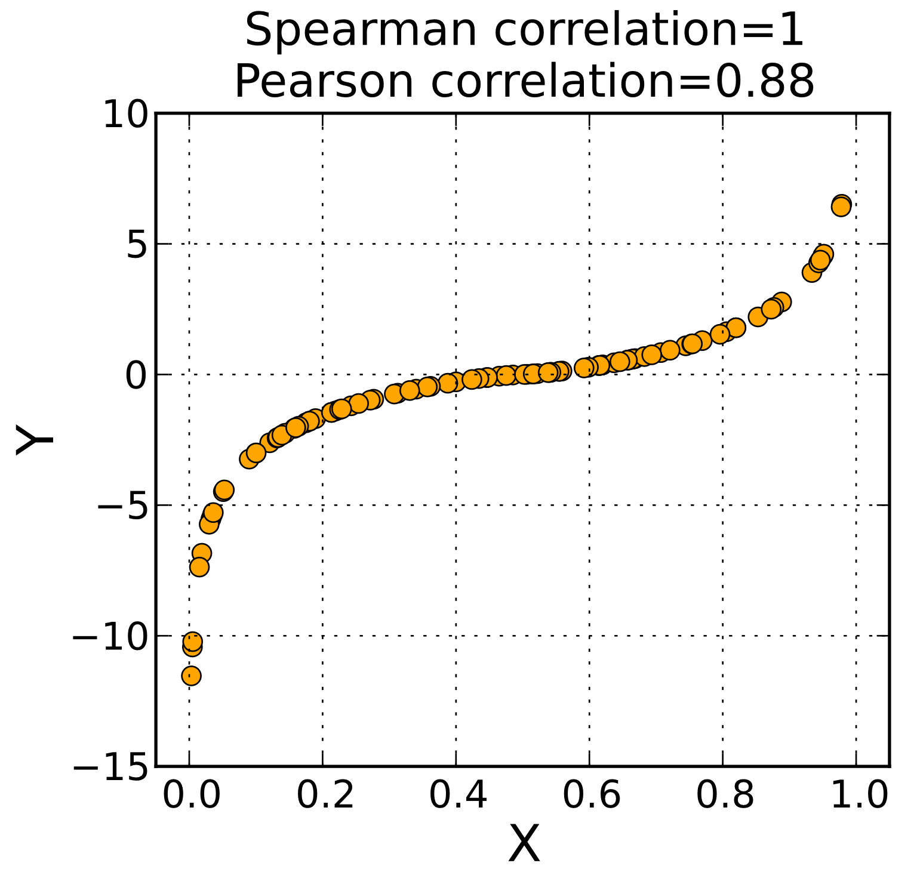
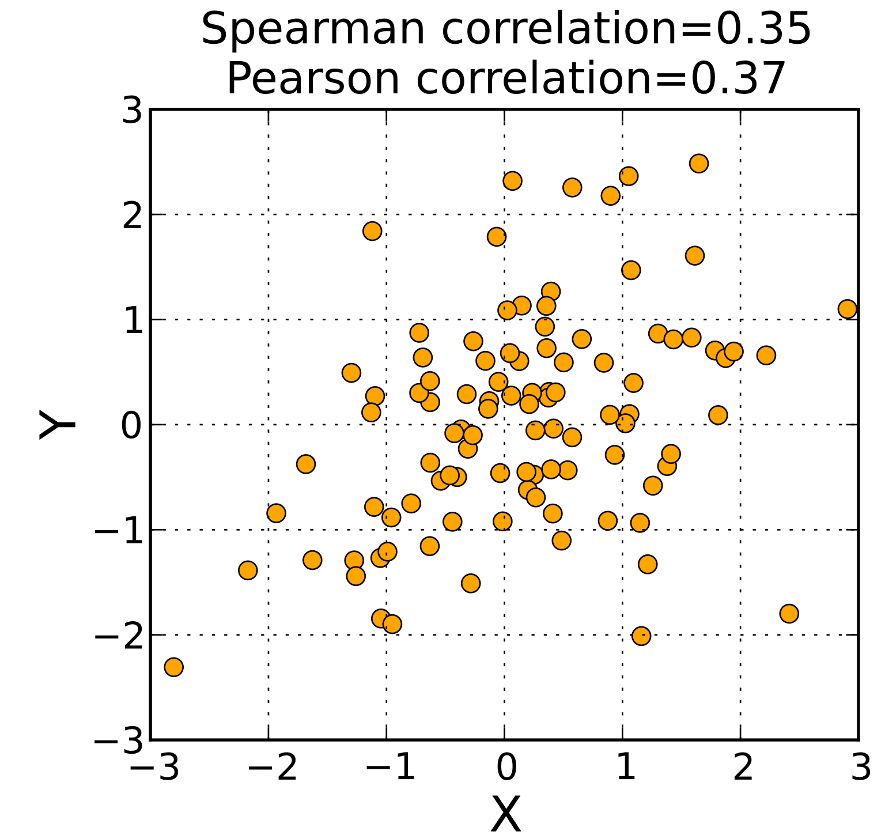
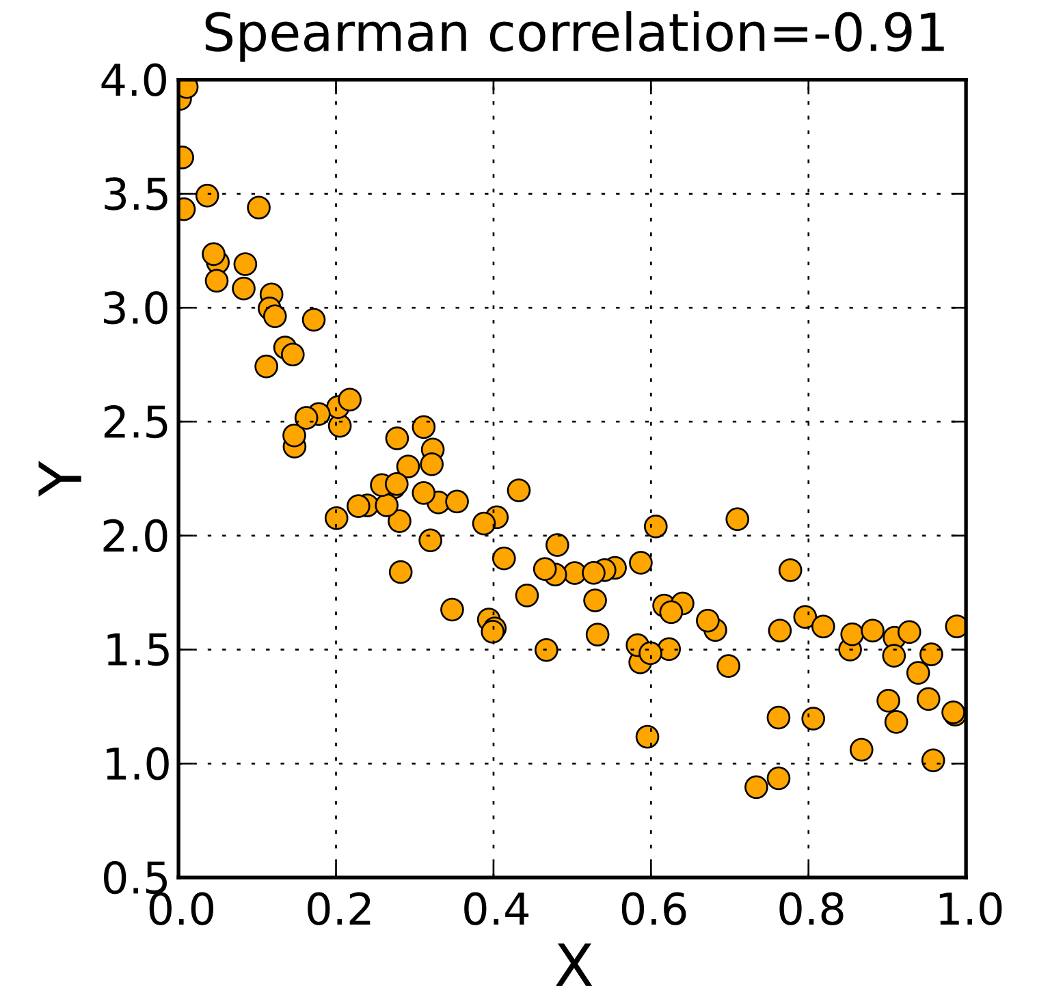
Spearman’s correlation
Examples of scatter diagrams with different values of Spearman’s correlation coefficient Ref: https://en.wikipedia.org/wiki/Spearman%27s_rank_correlation_coefficient

Slide 20
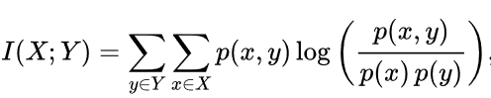
Mutual information
Mutual information between two random variables X and Y, I(X;Y), is a measure of the mutual dependence between the two variables
Quantifies the amount of information about one random variable, through the other random variable
Defined as: Where p(x,y) is the joint probability distribution and p(x) and p(y) are marginal probability distributions

Slide 21
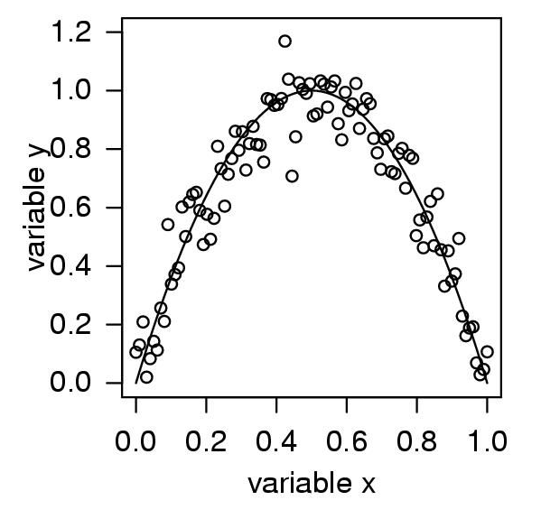
Mutual information
Dataset with very high mutual information value. Pearson correlation value is close to zero.
Ref: Daub, Carsten O., et al. "Estimating mutual information using B-spline functions–an improved similarity measure for analysing gene expression data." BMC bioinformatics 5.1 (2004): 118.

Slide 22
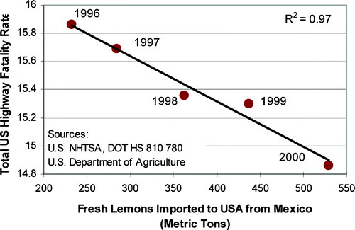
Association vs causation
Is there an association? Is there causation?
Ref: Johnson, Stephen R. "The trouble with QSAR (or how I learned to stop worrying and embrace fallacy)." Journal of Chemical Information and Modeling 48.1 (2008): 25-26.

Slide 23
MOG tutorial

